Slide 1

Project Miracle Presentation
Miracle Team @ Innovation Competition(InnoComp) 2017
INTERNAL

Slide 2


Project Introduction
We would like to implement a Personal Banking Voice Assistant which is targeted for elderly users to manage their monetary stored in the bank (Info query, account transfer etc), the elderly users is not accustomed to complex UI on smart phone and prefer talking with bank tellers.
Features:
Logon with biometric technology such as fingerprint or face recognition.
It can tell the balance of user’s account in voice.
It can recognize the voice instruction from elderly users, the voice instruction may be in dialect or localism.
It can translate the message for balance inquiry, payment and so on in voice in dialect or localism.
It can be run in mainstream portable devices, such as computer desktop, Smartphone and Pad (Android or iOS).
Voice Assistant
Every operations are in voice
Portable Teller
Personal bank teller in your hand
INTERNAL

Slide 3













前端
后端
银行后台
以微信小程序/桌面客户端为载体
使用人工智能框架
接受机器指令
微信易用
自然语言处理技术
提供用户帐户信息
界面简单
提供基本帐户操作
自然语言对话
卷积神经网络
使用生物特征识别
提供用户生物特征比对
INTERNAL
Notes:
汇丰碳融资策略？——投资促进低碳经济

Slide 4









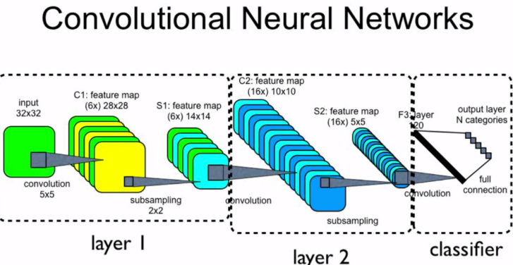

Technology Stacks of Miracle Team
Our team will make use of the following technology stacks:
Front-end
Back-end
Artificial Intelligence
INTERNAL

Slide 5


Project Plan
Our team will adopt Agile and DevOps in the project:
Project Plan
Scope | Action Item | Code Drop | Date
Back-end | AI Scaffold Building | 0 | Nov 20th ~ Nov 24th
 | CNN and RNN Algorithm Research | 0, 1 | Nov 20th ~ Dec 3rd
 | API Design | 1 | Nov 25th ~ Dec 3rd
 | AI Module Development | 1, 2, 3 | Nov 25th ~ Dec 12th
 | Banking Back-end Simulator Development | 2, 3 | Dec 4th ~ Dec 12th
 | Testing and Deployment | 3 | Dec 11th ~ Dec 14th
Front-end | WeChat Applet Registration and Configuration | 1 | Nov 25th ~ Dec 1st
 | Microsoft Azure Service Configuration | 1 | Nov 30th ~ Dec 3rd
 | API Design | 1 | Nov 25th ~ Dec 3rd
 | Web Page Development | 2 | Dec 4th ~ Dec 10th
 | Desktop Client Development | 2, 3 | Dec 4th ~ Dec 12th
Consolidation and Demonstration |  |  | Dec 14th
INTERNAL

Slide 6

Dear Innovation China Team,
Our team are anxious to show our development talents in InnoComp 2017. Please nominate us as one of the competitors of InnoComp 2017.
Thank you!
INTERNAL

